Slide 1
Test Automation Unit-V
Prepared by: Neha Tripathi

Slide 2
Automated Testing
Lecture 1

Slide 3
Introduction
Software Test automation makes use of specialized tools to control the execution of tests and compares the actual results against the expected result. Usually, regression tests, which are repetitive actions, are automated.
Testing Tools not only helps us to perform regression tests but also helps us to automate data set up generation, product installation, GUI interaction, defect logging, etc.
Automation tools are used for both Functional and Non-Functional testing.
Testing automation is effective such that any kind of repetitive and tedious activities can be done by machines, and testers can utilize their time in more creative and critical work.
However, automated testing should not be viewed as a replacement for manual testing as there are many activities in the testing life cycle which cannot be automated and manual effort is required. It must be seen as an enhancement to the manual testing process

Slide 4
Need/Benefits for Automation
Reduction of testing effort
Reduces the testers’ involvement in executing tests
Facilitates regression testing
Avoids human mistakes
Reduces overall cost of the software
Simulated testing
Internal testing
Test enablers
Test case design

Slide 5
Categorization of Testing Tools
A single tool may not cover the whole testing process, therefore, a variety of testing tools are available according to different needs and users. Different catagories are:
Based on the type of execution of test cases:
- Static Testing Tools
- Dynamic Testing Tools
Based on Testing Activity Tools:
- Tools for Reviews and inspections
- Tools for Test planning
- Tools for Test design and development
- Tools for Test execution and evaluation

Slide 6
Static and Dynamic Testing Tools
Static testing tools
For static testing, there are static program analyzers which scan the source program and detect possible faults and anomalies. These static tools parse the program text, recognize the various sentences, and detect the following:
- Statements are well-formed.
- Inferences about the control flow of the program.
- Compute the set of all possible values for program data.
Static tools perform the following types of static analysis:
- Control flow analysis
This analysis detects loops with multiple exits and entry points and unreachable code.
- Data use analysis
It detects all types of data faults.
- Interface analysis
It detects all interface faults. It also detects functions which are never declared and never called or function results that are never used.
- Path analysis
It identifies all possible paths through the program and unravels the program’s control.

Slide 7
Continue….
Dynamic testing tools : These tools support the following:
- Dynamic testing activities.
- Many a times, systems are difficult to test because several operations are being performed concurrently. In such cases, it is difficult to anticipate conditions and generate representative test cases. Automated test tools enable the test team to capture the state of events during the execution of a program by preserving a snapshot of the conditions. These tools are sometimes called program monitors.
The monitors perform the following functions:
- List the number of times a component is called or line of code is executed. This information about the statement or path coverage of their test cases is used by testers.
- Report on whether a decision point has branched in all directions, thereby providing information about branch coverage.
- Report summary statistics providing a high-level view of the percentage of statements, paths, and branches that have been covered by the collective set of test cases run. This information is important when test objectives are stated in terms of coverage.

Slide 8
Testing Activity Tools
Tools for Reviews and inspections
- Complexity analysis tools
It is important for testers that complexity is analyzed so that testing time and resources can be estimated. The complexity analysis tools analyze the areas of complexity and provide indication to testers.
- Code comprehension
These tools help in understanding dependencies, tracing program logic, viewing graphical representations of the program, and identifying the dead code. All these tasks enable the inspection team to analyze the code extensively.

Slide 9
Continue….
Tools for Test planning
- Templates for test plan documentation
- Test schedule and staffing estimates
- Complexity analyzer

Slide 10
Continue….
Tools for Test design and development
- Test data generator
It automates the generation of test data based on a user defined format. These tools can populate a database quickly based on a set of rules, whether data is needed for functional testing, data-driven load testing, or performance testing.
- Test case generator
It automates the procedure of generating the test cases. Test case generator uses the information provided by the requirement management tool and creates the test cases. The test cases can also be generated with the information provided by the test engineer regarding the previous failures that have been discovered by him. This information is entered into this tool and it becomes the knowledge-based tool that uses the knowledge of historical figures to generate test cases.

Slide 11
Continue….
Tools for Test execution and evaluation
- Capture/playback tools
These tools record events (including keystrokes, mouse activity, and display output) at the time of running the system and place the information into a script. The tool can then replay the script to test the system.
- Coverage analysis tools
These tools automate the process of thoroughly testing the software and provide a quantitative measure of the coverage of the system being tested.
- Memory testing tools
These tools verify that an application is properly using its memory resources.

Slide 12
Continue….
- Test management tools
Test management tools try to cover most of the activities in the testing life cycle. These tools may cover planning, analysis, and design.
- Network-testing tools
There are various applications running in the client-server environments. These tools monitor, measure, test, and diagnose performance across an entire network.
- Performance testing tools
Performance testing tools help in measuring the response time and load capabilities of a system specially for real time systems.

Slide 13
Automated Testing
Lecture 2

Slide 14
Selection of Testing Tools
It may depend on several factors like what are the needs of the organization; what is the project environment ; what is the current testing methodology; all these factors should be considered when choosing testing tools.
Some guidelines to be followed by selecting a testing tool are
- Match the tool to its appropriate use
- Select the tool to its appropriate SDLC phase
- Select the tool to the skill of the tester
- Select a tool which is affordable
- Determine how many tools are required for testing the system
- Select the tool after examining the schedule of testing

Slide 15
Costs incurred in Testing Tools
Automation is not free. Obviously employing the testing tools incur a high cost. Moreover, before acquiring the tools, significant work is required like:
- Automated script development
- Training is required
- Configuration management
- Learning curve for the tools
- Testing tools can be intrusive
- Multiple tools are required

Slide 16
Guidelines for Automated Testing
It is necessary that you carefully plan the automation before adopting it. Decide which tool and how many tools are required, how much resources are required including the cost of the tool and the time spent on training. Few guidelines are:
Consider building a tool instead of buying one, if possible
Test the tool on an application prototype
Not all the tests should be automated
Select the tools according to organizational needs
Use proven test-script development techniques
Automate the regression tests whenever feasible

Slide 17
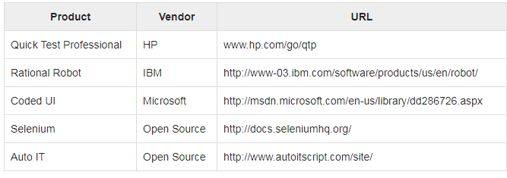
Testing Tools that are used for Functional automation:

Slide 18
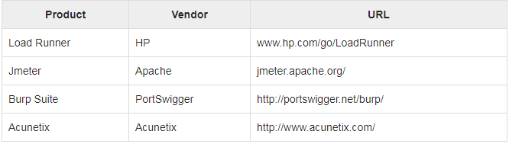
Testing Tools that are used for Non Functional automation:

Slide 19
Overview of some commercial Testing Tools
Mercury Interactive’s WinRunner
It is a tool used for performing functional/ regression testing. It automatically creates the test scripts by recording the user interactions on GUI of the software. These scripts can be run repeatedly whenever needed without any manual intervention. The test scripts can also modified if required because there is support of Test Script language ( TSL) with a ‘C’ like syntax. There is also provision for bringing the application to a known state if any problem has occurred during automated testing. WinRunner executes the statements by default with an interleaving of one second. But if some activities take more time to complete, then it synchronizes the next test cases automatically by waiting for the current operations to be completed.

Slide 20
Continue…
Segue Software’s SilkTest
This tool is also for functional/regression testing. It supports 4Test as a scripting language which is an object-oriented scripting language. SilkTest has a provision for customized in-built recovery system which helps in continuing the automated testing even if there is some failure in between.

Slide 21
Continue…
IBM Rational SQA Robot
It is another powerful tool for functional/regression testing. Synchronization of test cases with a default delay of 20 seconds is also available.

Slide 22
Continue…
Mercury Interactive’s LoadRunner
This tool is used for performance and load testing of a system. Generally, the tool is helpful for client/server applications of various parameters with their actual load like response time, the number of users, etc. The major benefit of using this tool is that it creates virtual users on a single machine and tests the system on various parameters. Thus, performance and load testing is done with minimum infrastructure.

Slide 23
Continue…
Apache’s JMeter
This is an open-source software tool used for performance and load testing.

Slide 24
Continue….
Mercury Interactive’s TestDirector
TestDirector is a test management tool. It is a web-based tool with the advantage of managing the testing if two teams are at different locations. It manages the test process with four phases: specifying requirements, planning tests, running tests, and tracking defects. Therefore, there is advantage that the tests are planned as per the requirements evolved. Once the test plan is ready, the test cases are executed. Defect-tracking can be done in any phase of test process. During defect-tracking, new bug can be reported; assign responsibility to someone for bug repair; assign priority to the bug; bug repair status can be analyzed, etc. This tool can also be integrated with LoadRunner or WinRunner.

